Slide 1

Image Resizing Algorithms
Ryan Mia

Slide 2
Stretching vs Resizing
Stretching – Changes the dimensions of the pixels in an image^{[1]}
Resizing – Increases or decreases number of pixels from an image^{[1]}

Slide 3
Interpolation and Decimation
Interpolation - Creates samples in between our original pixels, creating an output similar to if the original image was sampled at a higher rate^{[2]}
Decimation – Removes samples from our original image, creating an output with less samples^{[3]}
The focus of this presentation will be on Interpolation (Upscaling)

Slide 4
Image Upscaling Crux
Information can not be create from nothing, so we need to “guess” what the up sampled pixels will be^{[1]}
We will look at two fundamentally different ways to do this

Slide 5
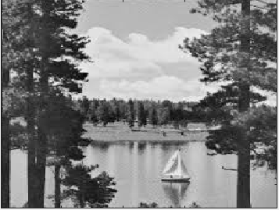
Algorithms Covered
Nearest-neighbor
Frequency-Domain Zero-Padding
There are many more…
Original Image at Scale^{[4]}

Slide 6
Nearest-Neighbor Interpolation
Naive algorithm that takes advantage of spatial locality to interpolate intermediary samples by copying the nearest sample^{[5]}
The naivety of this algorithm causes jagged edges and distorted spots.
Bilinear and Bicubic interpolations use information from multiple surrounding pixels to improve image quality

Slide 7
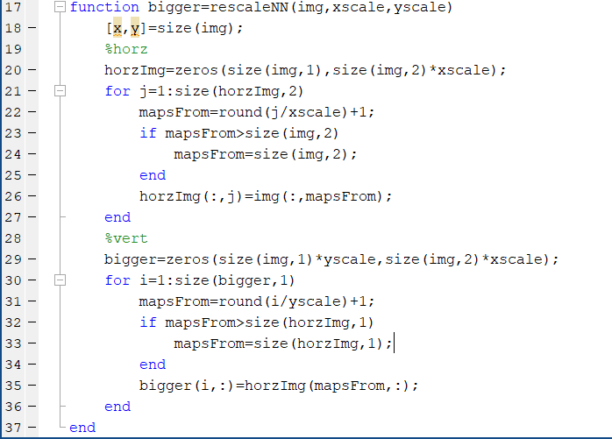

Slide 8
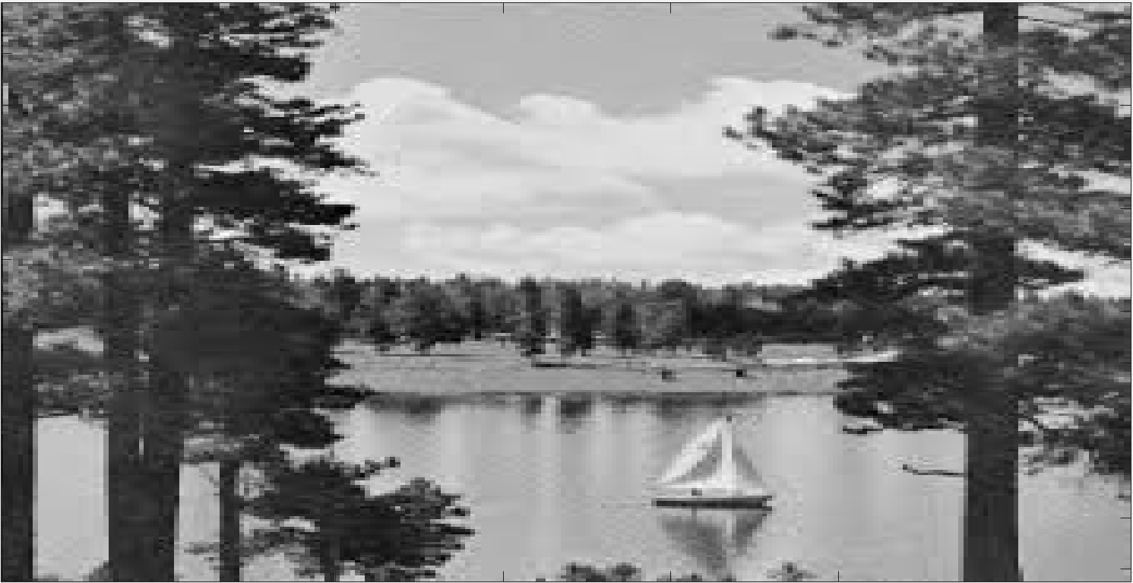
Nearest-Neighbor Interpolation

Slide 9
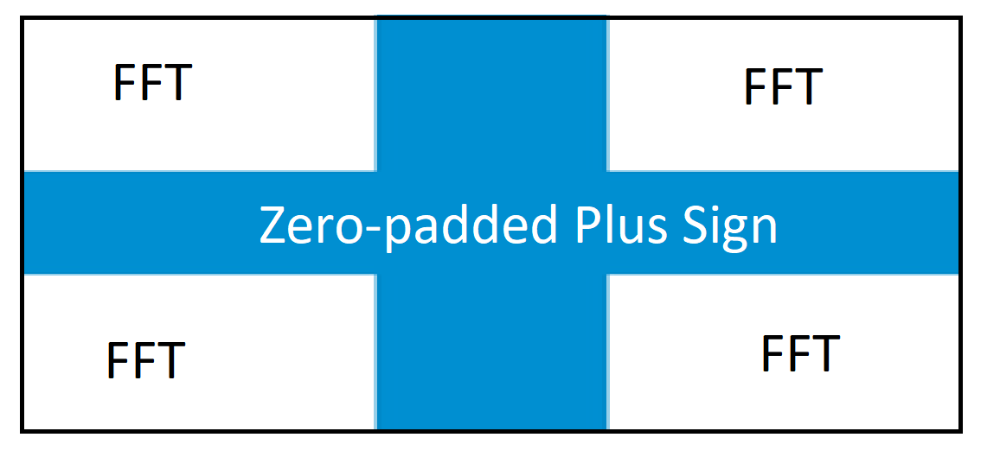
Frequency-Domain Zero-Padding Interpolation
Use Fourier Transform (FFT) to go to frequency domain, add samples in the frequency domain, and then inverse FFT back to Spatial Domain^{[6]}
The “FFT” is split into four
section, and Zero-padded until
size is met in X and Y

Slide 10
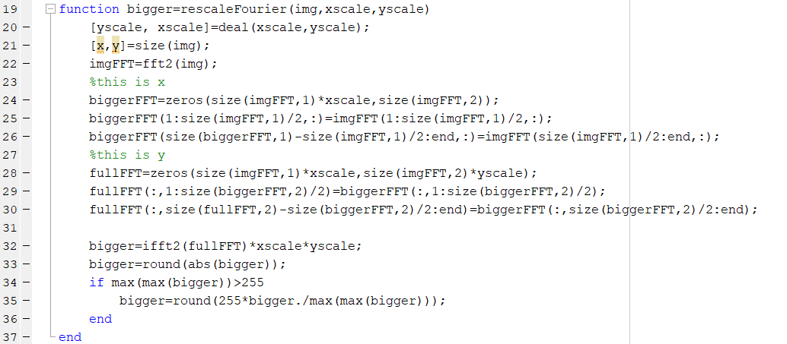

Slide 11

Fourier Transform Method

Slide 12
Takeaways
Image Resizing is intertwined with interpolation and decimation of your sample rate
Nearest Neighbor and FDZP are two (of many) techniques and use different principles to solve
But both had flaws and any algorithm will be imperfect, improvements possible

Slide 13
References
[1] https://guides.lib.umich.edu/c.php?g=282942&p=1885347
[2] https://dspguru.com/dsp/faqs/multirate/interpolation/
[3] https://dspguru.com/dsp/faqs/multirate/decimation/
[4] https://ieeexplore.ieee.org/stamp/stamp.jsp?arnumber=8590698
[5] https://www.giassa.net/?page_id=207
[6] https://dspguru.com/dsp/howtos/how-to-interpolate-in-time-domain-by-zero-padding-in-frequency-domain/

